Slide 1

A STUDY ON UNDERLYING STRUCTURE OF A GOLD PRICE DATASET AND BULIDING FORECASTING MODEL FOR PRICE PREDICTION
By
GROUP -04
ASHUTOSH DHAKE
MANOJ
MUJTABA HUSSAIN
NAGADARSHAN R
SAGAR
SWETHA M V
Under the guidance of
KARTHIK MUSKULA
Date
14-Apr-2022

Slide 2
BUSINESS PROBLEM:
Gold price fluctuations affecting the investment and revenue goals of the company
OBJECTIVES:
The main objective is to understand the underlying structure in the dataset
come up with a suitable forecasting model which can effectively forecast gold prices for next 30 days.

Slide 3
PROJECT ARCHITECTURE / PROJECT FLOW:
Business Problem
Project Discussions
Dataset details
Exploratory Data Analysis (EDA)
Model Building
Model Evaluation
Feedback
Deployment

Slide 4
Exploratory Data Analysis (EDA) and
Feature Engineering

Slide 5
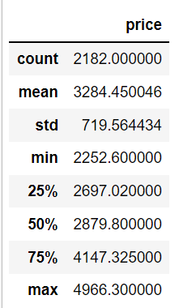
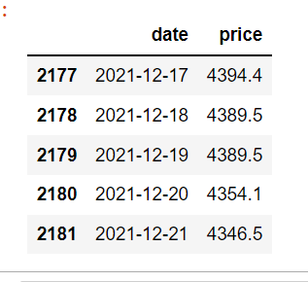
Data set details
Shape of the Dataset- 2182*2
Number of unique values- Price= 1876
Date= 2182
Data ranges- Price= 2252.6 to 4966.3
Date= 01/01/2016 to 21/12/2021
Missing values – no missing or null values
Data Descriptions

Slide 6
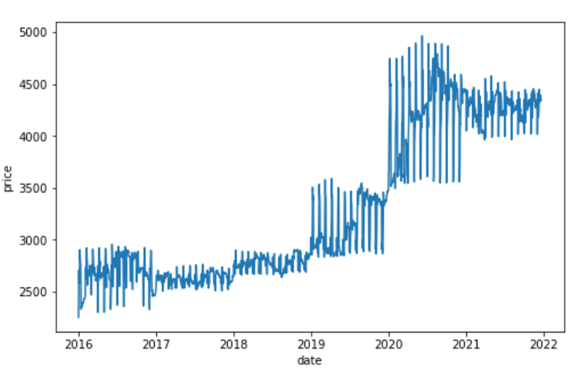
Exploratory Data Analysis (EDA)
There’s been an sudden rise in gold prices after 08/03/2020 and a significant decrease after 01/11/2020
The prices are having a upward Trend.

Slide 7
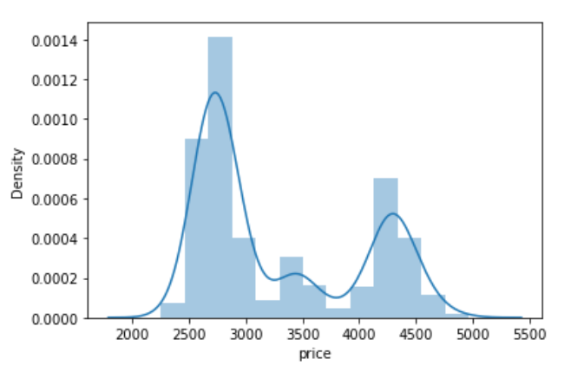
EDA
Histogram – Data is NOT normally distributed and is Skewed.

Slide 8
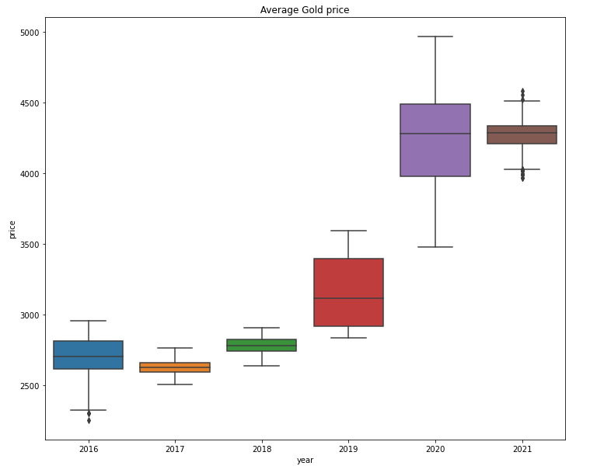
Boxplot for yearly data:

Slide 9
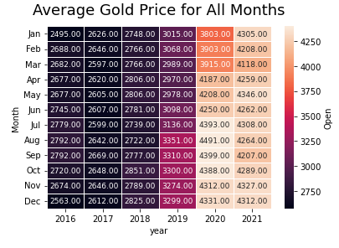
Heat map for monthly average prices

Slide 10
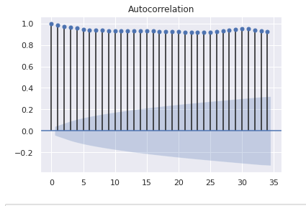
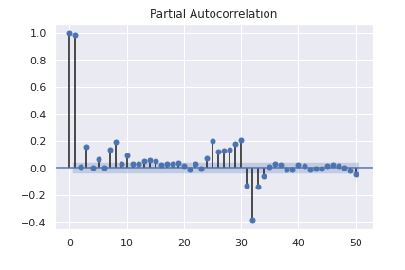
Auto Co relation and partial auto co relation plot
Data is non stationary as we can see in the plot it is taking too many lags to decay.

Slide 11
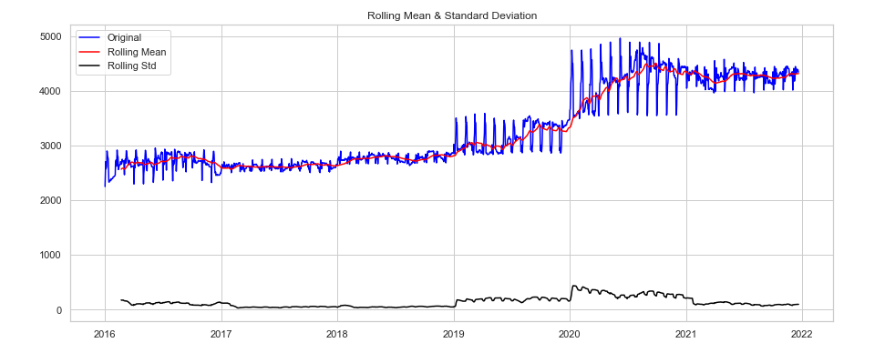
ASTATIONARITY CHECK PLOT - Rolling statistics and Augumented Dickey Fuller test -The data has positive trend and varying standard deviation and is dependent of time, it is not stationary

Slide 12
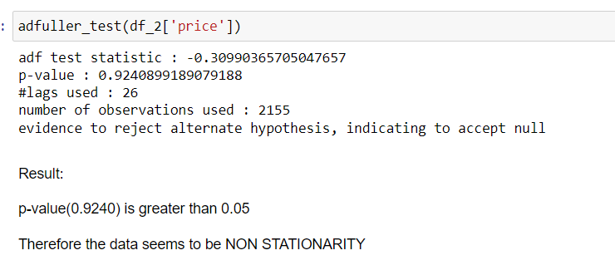
Dicky Fuller Test for stationarity

Slide 13
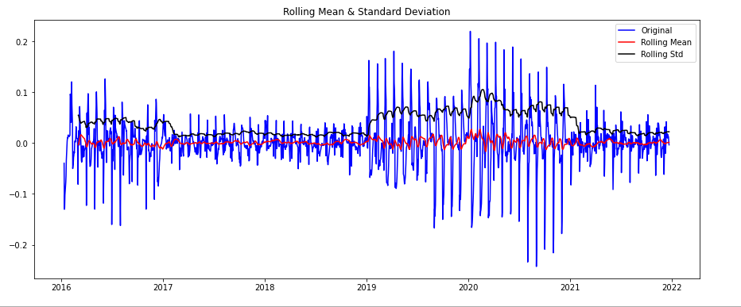
TRANSFORMATION WE USED TO MAKE THE DATA STATIONARY. 1]Log Transformation. 2]Time shift Transformation. 3] Differencing method 4] Moving average method

Slide 14
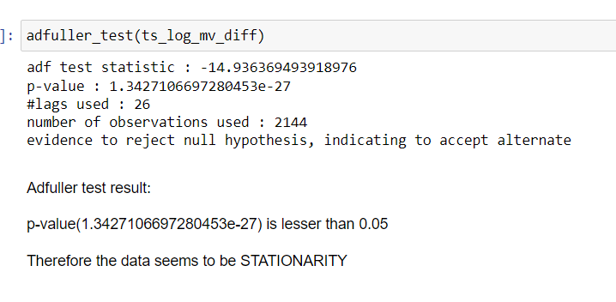
Dicky-Fuller statistic after transformation

Slide 15
Model Building
1. Data driven model
a. Simple Exponential Smoothing method
b. Holt method
c. Holt Winters method
2. ARIMA model (Auto Regressive Integrated Moving Average method)

Slide 16
Model Evaluation
Serial No. | Model Name | RMSE | MAPE
1 | ARIMA | 98.90 | 0.18
2 | SES | 243.6 | 3.76
3 | Holt method | 15120.1 | 113.8
4 | Holts winter with additive seasonality & trend | 583.6 | 12.46
5 | Holts winter with seasonality(MUL) & trend(ADD) | 697.8 | 14.7

Slide 17
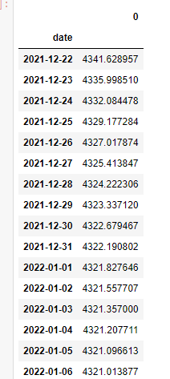
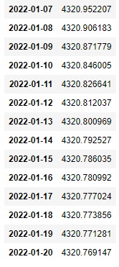
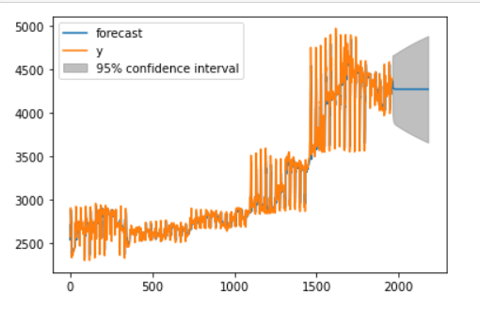
Model Predictions

Slide 18
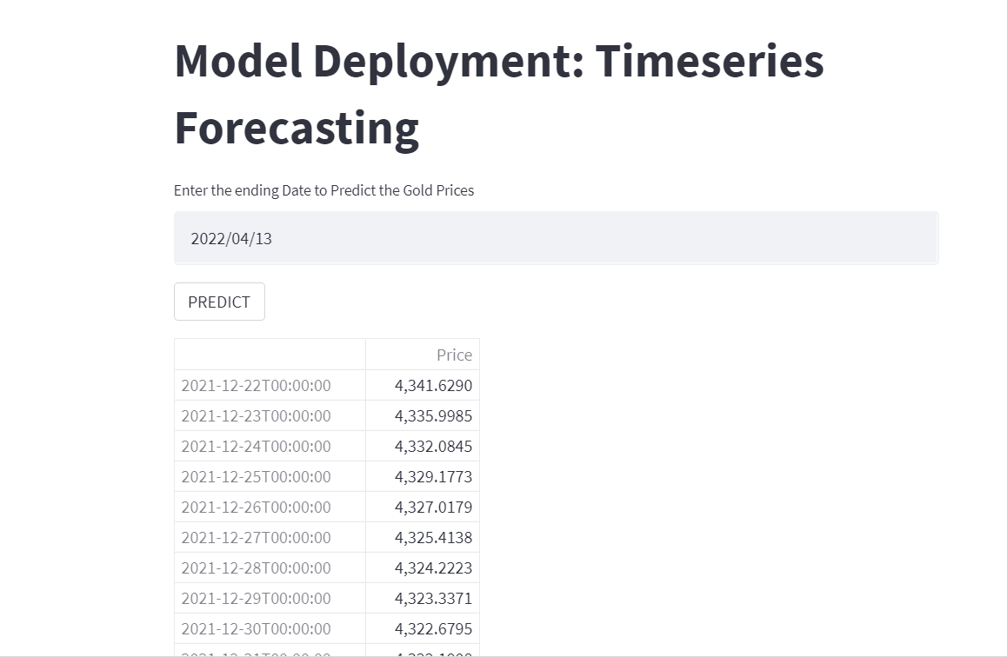
Model Deployment using Streamlit

Slide 19
Thank you

